Slide 1

Capstone Project
Tokyo Clustering Based on Food, Entertainment, Sightseeing, Shopping
Melih Onur Temel

Slide 2
Introduction
The capstone project is about 23 wards of City Tokyo and the municipality is gonna try to come up with a strategy to increasing demand of tourism in a best way possible
In the case study the municipality of Tokyo will try to classify the wards as a 3 groups and the main topics in order to determine it will be based on 4 categories.
Wards : 'Chiyoda', 'Chūō', 'Minato', 'Shinjuku', 'Bunkyō', ‘Taitō', 'Sumida', 'Kōtō', 'Shinagawa', 'Meguro', 'Ōta', 'Setagaya', 'Shibuya', 'Nakano', 'Suginami', 'Toshima', 'Kita', 'Arakawa', 'İtabashi', 'Nerima', 'Adachi', 'Katsushika', 'Edogawa'.

Slide 3
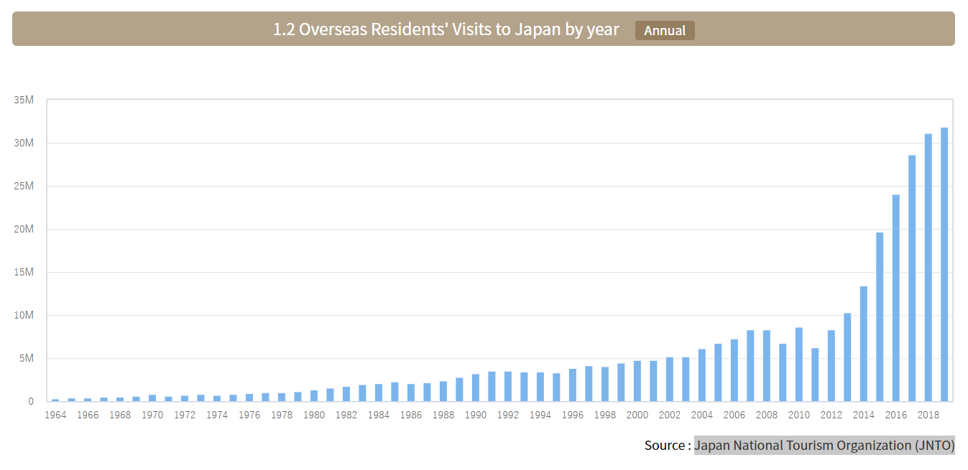
Reference:
Japan-bound Statistics - Tourism Statistics. (n.d.). Retrieved from https://www.tourism.jp/en/tourism-database/stats/inbound/#annual

Slide 4
Business Understanding
The problem that we are trying to solve is about how to determine the wards and when making investments for further developments is will be useful to know the characteristics of the wards. This can be useful because each year the city of Tokyo attracts more tourists and also there is Olympics coming to city.
Clustering approach has been chosen as the analytic approach

Slide 5
Data
“geopy” library of python and 23 geographical location as latitude and longitude will be gathered after the correct implementation of the package. The format of the data in numerical values because it will be used in Foursquare API to collect the popular places around the spots given as parameters
After the location data gathered region must be inspected to find the popular places around specific geographical location.
To find the popular venues for each category bar charts or other graphs may help us and they can depict the popular venue types

Slide 6
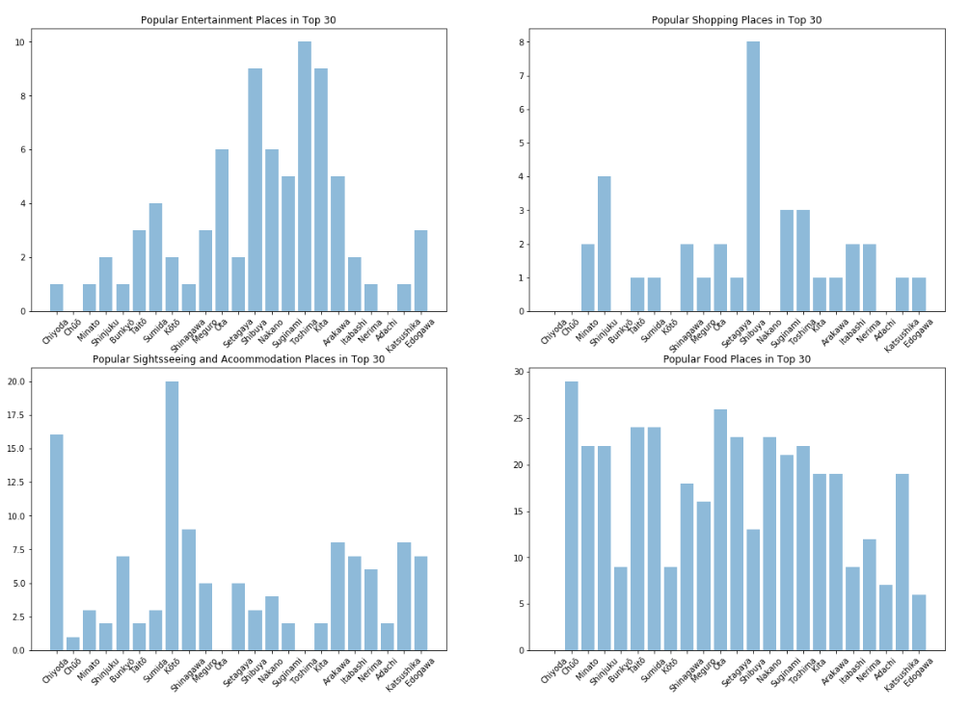
Visualization

Slide 7
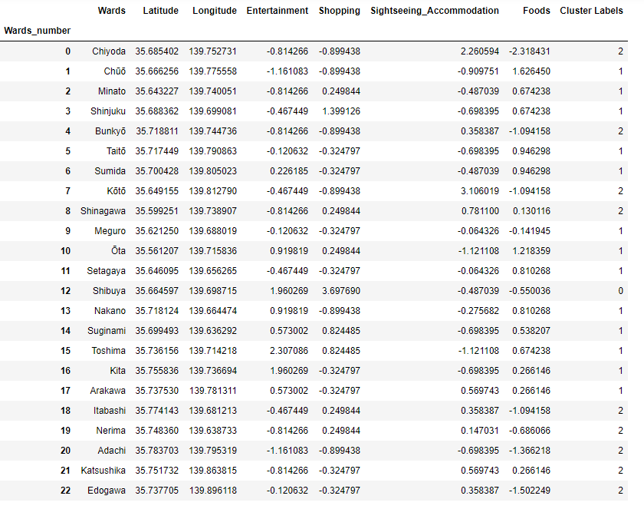
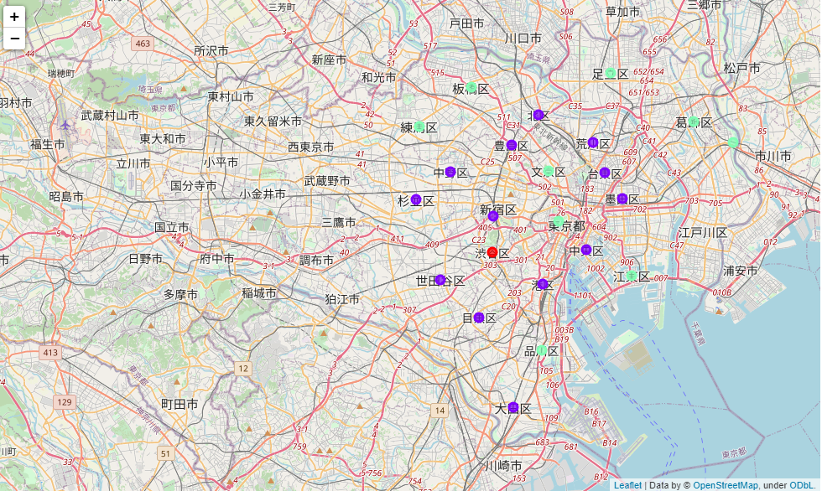
Results

Slide 8
Discussions and Conclusion
Results show us the relationships between the wards and according to that 9 wards depicted in green dots, 1 ward which is Shibuya ward depicted in red dot and all the remainings are depicted in blue dots based on the 4 different groups made by aggregation of type of the popular placed on the ward selected.
The unique region can be promoted differently than the other regions if the municipality decides to promote them in future.
The further analysis such as more than 30 places to explore or wider radius choice must be implemented if it is really done on actual project but this small frame gives hint about how it may be done and good illustration of the basic points.
Connecting the regions sharing same characteristics with different means of transportation could be another choice if the desire is based on the centralization of unique characteristics such as Chiyoda and Koto for sightseeing and accommodation spots.
Increasing the tourism agencies or implementing the western or pacific region country type hotels may be another strategy but to decide the efficacy and effectiveness of the project other socio-economic perspectives must be taken into account. This is just a small frame but it gives precious hints for the decision makers and illustrates the situation.

